Slide 1
Team-22
Simulating Drip Irrigation (DI) System For Optimizing Water Use Efficiency
Labiba Tasfiya Jeba ; ID: 22266028
Abrar Al Sayem ; ID: 18201194
Tasfia Anika Bushra ; ID: 23166013
ST: Farah Binta Haque
RA: Md Sabbir Hossain

Slide 2
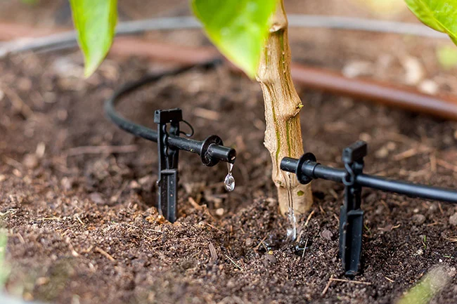
TOC
TOC
Project overview
Introduction
Related Work
Methodology
Simulation Setup
Next step & Conclusion

Slide 3
Project Overview
This project aims to develop a simulation model named Drip Irrigation System Simulation (DISS) that optimizes water use in drip irrigation (DI) systems by integrating soil moisture data, weather forecasts, and crop water requirements. The model will provide farmers and agricultural professionals with a valuable tool for making informed irrigation decisions, conserving water, and enhancing crop yields.

Slide 4
Introduction
Drip irrigation saves water compared to traditional methods like furrow irrigation.
Drip Irrigation System Simulation (DISS) helps users understand, optimize, and manage drip irrigation systems.
DISS models drip irrigation performance under various weather and soil conditions.
Provides insights into irrigation needs, system efficiency, and water usage patterns.
Helps farmers, engineers, and researchers optimize irrigation schedules, enhance system efficiency, and conserve water.
DISS evaluates different irrigation designs and practices to maximize crop yields while minimizing water use.

Slide 5
Introduction
Significance of DISS
Combating Water Scarcity
Promoting Sustainability
Enhancing Crop Productivity
Achieving Economic Efficiency
Applications of DISS
Irrigation System Design
Irrigation Scheduling

Slide 6
Related Work
In paper 1, researchers built irrigation models for citrus orchards in dry areas. They tested different water amounts and found the best ways to water the trees for both fruit quality and water savings. This helps farmers in dry regions plan their watering to get the best results.
Abioye et al. (2021) developed an IoT-based drip irrigation system to precisely monitor and control water usage during mustard leaf cultivation in paper 2. The system used sensors to collect data on soil moisture, climate, and irrigation volume, and this data was then used to create a predictive model that could estimate future water needs. The system also allowed for real-time monitoring of soil moisture and irrigation, which helped to optimize water management.
Researchers have developed a VR machinery simulator in paper 3 that uses a real tractor cab and open-source software to create realistic driving scenarios. This allows farmers and researchers to test different equipment and precision agriculture techniques without risking harm or damage to real equipment. This could revolutionize agricultural training and research by enabling the development of more efficient and sustainable farming practices.

Slide 7
Related Work
4. This paper 4 introduces an agriculture monitoring system built using Arduino and an Android smartphone. It helps farmers track soil moisture, temperature, and humidity in real-time, allowing them to make informed irrigation decisions and optimize crop yields. The Arduino board collects data, while the Android app displays it and enables remote monitoring, promoting sustainable water management.
5. Drip irrigation is much more efficient than border irrigation for corn. A study paper 5 found that drip irrigation used 28% less water and 39% less nitrogen fertilizer than border irrigation, while still producing the same amount of corn. This is because drip irrigation delivers water and nutrients directly to the roots of the plants, where they are needed most. This reduces waste and runoff, making it a more sustainable and environmentally friendly way to grow corn.
6. Paper 5 introduces a smart agriculture power system using IoT to optimize energy use and promote sustainability. It balances power demands and manages renewables with an algorithm, ensuring the system's continuous operation. Simulations validate its effectiveness in boosting reliability, stability, and efficiency, making it promising for sustainable smart agriculture.

Slide 8
Related Work
7. The CDCS is a novel approach to precision agriculture that uses distributed computing, cognitive computing, artificial intelligence, and the internet of things (IoT) to address the challenges faced by traditional agriculture in paper 7. It aims to improve water and fertilizer usage, pest and disease control, and real-time crop health monitoring and analysis.
8. This paper 8 investigates how cloud and distributed systems handle the huge data deluge from Agriculture 4.0. It compares different architectures like centralized cloud, distributed cloud, and collaborative models, finding their strengths and weaknesses for various agricultural data management needs. Additionally, it explores trendy technologies like edge computing, fog computing, and blockchain, suggesting how they might shape future data management in this domain.
9. A study [9] using the CROPGRO-Cotton model found that starting cotton crops with slightly moist soil (between 0.8 and full capacity) and maintaining moderate irrigation (30-36 mm) during the season led to the best yields and plant growth in the Tarim Basin. This information is valuable for optimizing irrigation and cotton production in the region.

Slide 9
Related Work
10. This paper proposes a new precision agriculture design method that uses a distributed computing architecture and the Internet of Things (IoT) to collect, analyze, and store large amounts of data from farms. This data can then be used to optimize irrigation, fertilization, and pest control, which can lead to increased crop yields and reduced environmental impact
11. The authors propose a standalone photovoltaic (PV) drip irrigation system to address water scarcity and reliance on grid electricity. This system uses solar panels to power an irrigation pump, delivering water directly to plant roots through a network of pipes and emitters, minimizing water waste. Simulations show the system effectively meets crop water needs while using solar energy, making it a sustainable and cost-effective solution for precision irrigation.
12. A study in Northwest China found that drip irrigation increased maize yields by up to 26.9% compared to traditional furrow irrigation. The researchers believe that this is due to the more precise water application and uniform soil moisture distribution that drip irrigation provides.

Slide 10
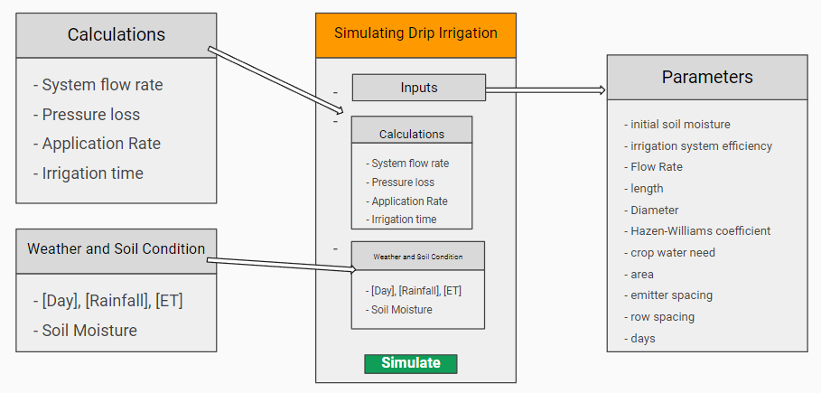
Methodology
Simulation Model

Slide 11
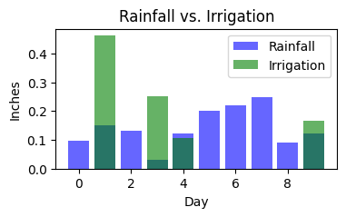
Methodology
Data Collection and Parameters
Assumption And Limitations
Analytical Techniques
Flow rate per emmiter
System specification
Crop water and area coverage
Emitter and row spacing
Weather data
Soil Moisture
Irrigation System efficiency
Simulation Execution
Data Analysis
Visualization Techniques

Slide 12
Simulation Setup
System Configuration
System components: Multiple emitters with flow rates between 0.5 and 1.0 GPH.
Irrigation line specifics: Length of 200 feet, diameter of 0.75 inches.
Hazen-Williams coefficient: Set at 140, affecting pipe roughness and flow.
Emitter and row spacings: Uniformly maintained at 1 foot, resembling typical grid layouts.
Environmental Condition
Daily weather generation: Includes random rainfall values (0 to 0.5 inches/day).
Evapotranspiration (ET0) rates: Varied between 0.1 and 0.3 inches/day.

Slide 13
Simulation Setup
Crop Water Requirements
Crop water requirement: Standardized at 1.0 inch per week for various agricultural crops.
Daily irrigation requirements: Determined by combining this standard need with simulated environmental conditions.
Cultivation area: Fixed at 1000 square feet, serving as the basis for calculating total water volume necessary for effective irrigation.
Implementation of the Simulation
Simulation duration: Spans 10 days with daily executions.
Daily calculations: Include total system flow rate, pressure loss due to pipe friction, and water application rate.
Soil moisture update: Occurs daily based on net soil moisture change considering rainfall, ET0, and applied irrigation.
Compensation mechanism: If soil moisture drops below crop water needs, the system increases irrigation while considering a 70% efficiency rate.

Slide 14
Simulation Setup
Along with accounting for both additional irrigation and natural rainfall, the model also tracks daily water usage. This information is essential for assessing how well the drip irrigation system uses and conserves water.

Slide 15
Next Step & Conclusion
We plan to show key system performance metrics in case of results.
The efficacy of water usage will be demonstrated
A sensitivity analysis will also be incorporated into the simulation to comprehend the effect of changing input parameters on the system's operation.
Comparative analysis with other similar systems will be shown
Overall, the simulation will be used to assess the need for irrigation, improve system performance, and understand water use patterns.

Slide 16
Reference
[1] F. Chen, N. Cui, S. Jiang, Z. Wang, H. Li, M. Lv, Y. Wang, D. Gong, and
L. Zhao, “Multi-objective deficit drip irrigation optimization of citrus
yield, fruit quality and water use efficiency using nsga-ii in seasonal arid
area of southwest china,” Agricultural Water Management, vol. 287, p.
108440, 2023.
[2] E. A. Abioye, M. S. Z. Abidin, M. S. A. Mahmud, S. Buyamin, M. K. I.
AbdRahman, A. O. Otuoze, M. S. A. Ramli, and O. D. Ijike, “Iot-
based monitoring and data-driven modelling of drip irrigation system
for mustard leaf cultivation experiment,” Information Processing in
Agriculture, vol. 8, no. 2, pp. 270–283, 2021.
[3] M. Cutini, C. Bisaglia, M. Brambilla, A. Bragaglio, F. Pallottino,
A. Assirelli, E. Romano, A. Montaghi, E. Leo, M. Pezzola et al., “A
co-simulation virtual reality machinery simulator for advanced precision
agriculture applications,” Agriculture, vol. 13, no. 8, p. 1603, 2023.

Slide 17
Reference
[4] N. Hashim, S. Mazlan, M. Aziz, A. Salleh, A. Jaafar, and N. Mohamad,
“Agriculture monitoring system: a study,” Jurnal Teknologi, vol. 77,
no. 1, pp. 53–59, 2015.
[5] Y. Wang, S. Li, H. Liang, K. Hu, S. Qin, and H. Guo, “Comparison
of water-and nitrogen-use efficiency over drip irrigation with border
irrigation based on a model approach,” Agronomy, vol. 10, no. 12, p.
1890, 2020.
[6] S. Munteanu, V. Sudacevschi, V. Ababii, R. Branishte, A. Turcan, and
V. Leashcenco, “Cognitive distributed computing system for intelligent
agriculture,” 2021.
[7] O. Debauche, S. Mahmoudi, P. Manneback, and F. Lebeau, “Cloud
and distributed architectures for data management in agriculture 4.0:
Review and future trends,” Journal of King Saud University-Computer
and Information Sciences, vol. 34, no. 9, pp. 7494–7514, 2022.

Slide 18
Reference
[8] X. Wang, H. Wang, Z. Si, Y. Gao, and A. Duan, “Modelling responses of
cotton growth and yield to pre-planting soil moisture with the cropgro-
cotton model for a mulched drip irrigation system in the tarim basin,”
Agricultural Water Management, vol. 241, p. 106378, 2020.
[9] F. J. Ferr ́andez-Pastor, J. M. Garc ́ıa-Chamizo, M. Nieto-Hidalgo, and
J. Mora-Mart ́ınez, “Precision agriculture design method using a dis-
tributed computing architecture on internet of things context,” Sensors,
vol. 18, no. 6, p. 1731, 2018.
[10] S. Miran, M. Tamoor, T. Kiren, F. Raza, M. I. Hussain, and J.-T.
Kim, “Optimization of standalone photovoltaic drip irrigation system:
A simulation study,” Sustainability, vol. 14, no. 14, p. 8515, 2022.
[11] Y. Wang, S. Li, Y. Cui, S. Qin, H. Guo, D. Yang, and C. Wang, “Effect
of drip irrigation on soil water balance and water use efficiency of maize
in northwest china,” Water, vol. 13, no. 2, p. 217, 2021.

Slide 19
Reference
[12] F. Cassel Sharmasarkar, S. Sharmasarkar, S. Miller, G. Vance,
and R. Zhang, “Assessment of drip and flood irrigation on water
and fertilizer use efficiencies for sugarbeets,” Agricultural Water
Management, vol. 46, no. 3, pp. 241–251, 2001. [Online]. Available:
https://www.sciencedirect.com/science/article/pii/S037837740000090

